Slide 1


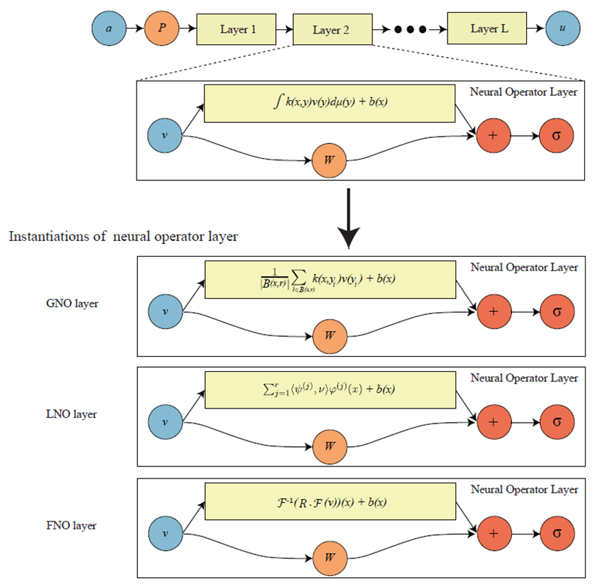
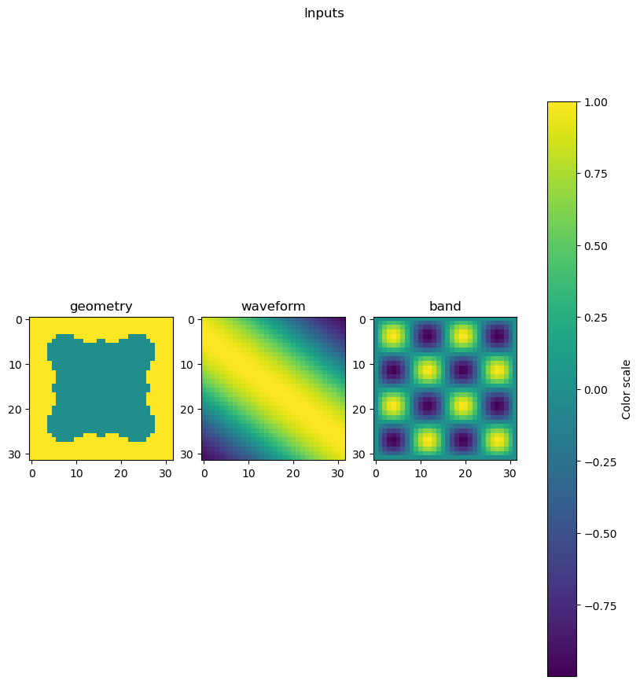
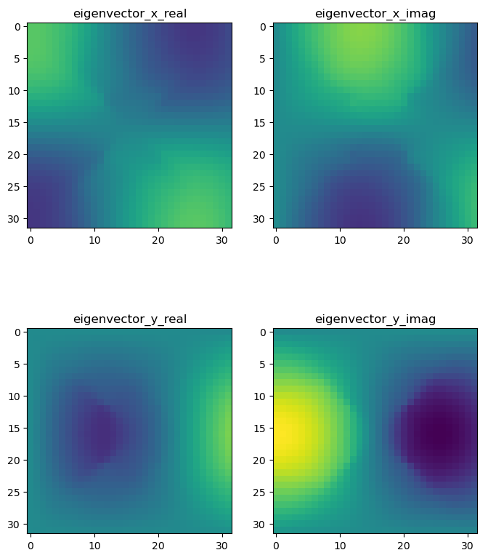
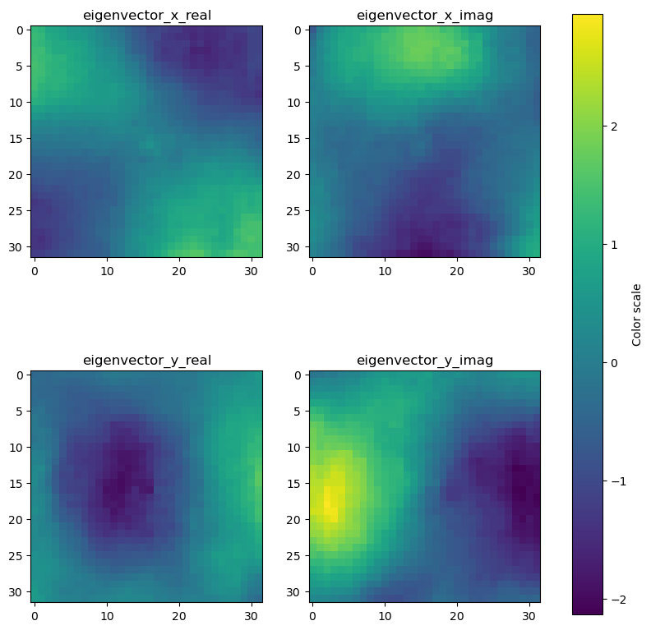
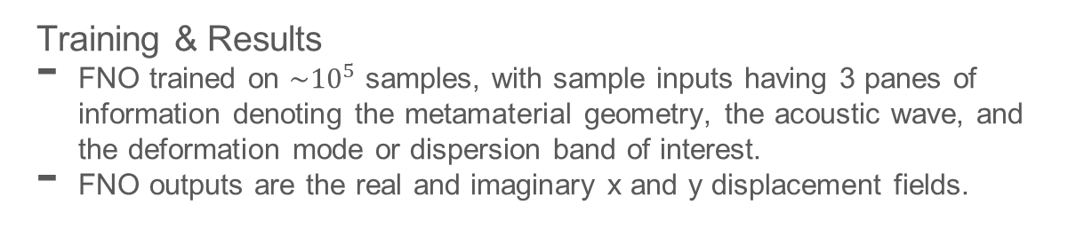
Fourier Neural Operator Learning of Acoustic Metamaterial Displacement Fields
Han Zhang, L. Catherine Brinson
Purpose & Motivation
Neural networks usually fail to generalize past its trained representation of data.
Neural operators attempt to make AI robust against resolution changes in representation of data, by mapping a discrete representation space to a continuous function space.
Training & Results
FNO trained on $\sim {10}^{5}$ samples, with sample inputs having 3 panes of information denoting the metamaterial geometry, the acoustic wave, and the deformation mode or dispersion band of interest.
FNO outputs are the real and imaginary x and y displacement fields.
Input Sample
Target Output
Output Sample
This material is based upon work supported by the National Science Foundation under Grant No. DGE-2022040

